Slide 1
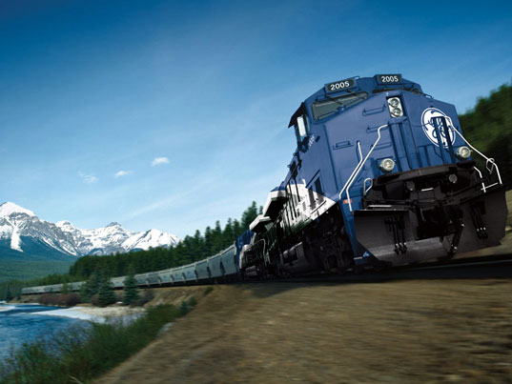
Railroad Block Signal
Railroad Block Signal Software Tool
Team Members:
Kenneth Truex
Chad Mason
Zachary McHenry
Christopher Diebold

Slide 2
Previous Goals
Task | Completion % | Kenneth Truex | Christopher Diebold | Chad Mason | Zachary McHenry | To Do
Obtain Requirement Document From GE | 100% | 50% | 50% | 0% | 0% | Ensure a full understanding of the “Shalls” associated with this project
Decide on IDE/Programming Language/Database Tools | 100% | 25% | 25% | 25% | 25% | Select a language and IDE/Tools that mesh well together

Slide 3
Previous Goals
Task | Completion % | Kenneth Truex | Christopher Diebold | Chad Mason | Zachary McHenry | To Do
Evaluate Selected Tools with Small Examples to Analyze Integration/Cohesiveness of Tools | 100% | 50% | 50% | 0% | 0% | Ensure a full understanding of the “Shalls” associated with this project
Begin Drafting Design of Program and GUI | 100% | 25% | 25% | 25% | 25% | Select a language and IDE/Tools that mesh well together

Slide 6
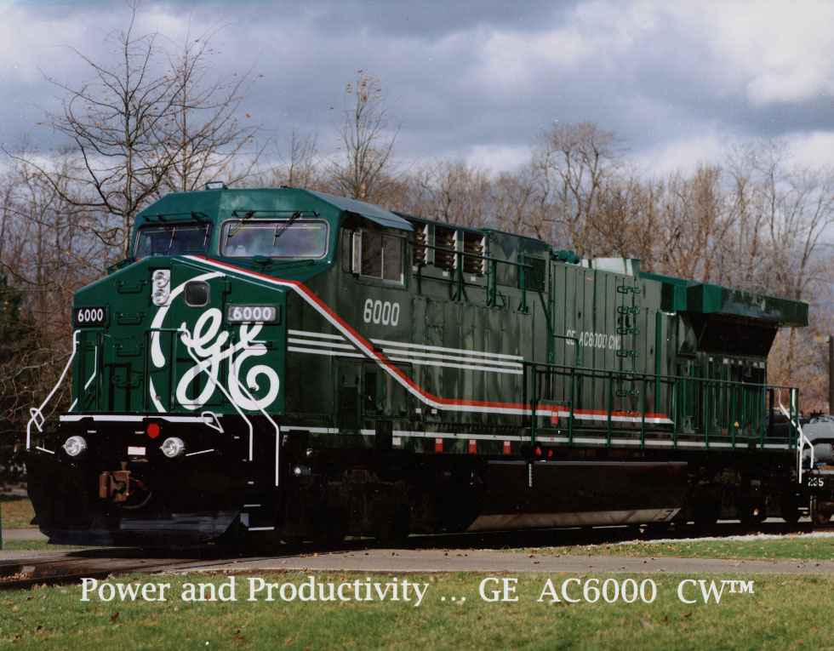
Milestones

Slide 7
Milestone 2
Parsing the database - Take our skeleton infrastructure of a database and add to it the functionality of information retrieval. Set it up so that the user can enter query commands and actually retrieve information stored in the database.
Do a GUI mockup and present to GE - Take our design documents of our GUI that we created in Photoshop and implement it into C# code. After completing the implementation, we will present it to Dan Ballesty for review and critique.

Slide 8
Milestone 3
Finalize approved GUI
Finish choosing algorithm
Begin modifying algorithm to fit with the project

Slide 9
Milestone 2 Role Distribution
Task | Chad | Ken | Chris | Zach
Parsing the Database information | - | 50% | 50% | -
Do a GUI Mockup and present to GE | 50% | - | - | 50%

Slide 10
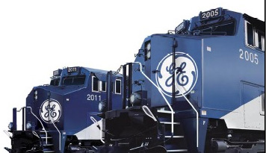
Any Questions?

